Slide 1
Establishing a Just, Learning Culture
Barriers to Implementation & Strategies
By: Brijette Baboolal

Slide 2
Objectives
• Define ‘Just Culture’ briefly
• Identify common barriers to implementation
• Provide practical strategies to overcome barriers
• Cite sources used

Slide 3
What is a 'Just Culture'?
• A culture balancing accountability and learning after errors.
• Focuses on system design and human factors rather than blame.
• Encourages reporting of errors/near-misses to improve safety.
Sources: David Marx (Just Culture), AHRQ CUSP.

Slide 4
Common Barriers to Implementing a Just Culture
• Fear of blame and punitive consequences
• Leadership inconsistency or lack of commitment
• Legal/liability concerns and regulatory pressures
• Poor communication and lack of psychological safety
• Insufficient training and education on just culture principles
• Measurement gaps and misaligned incentives

Slide 5
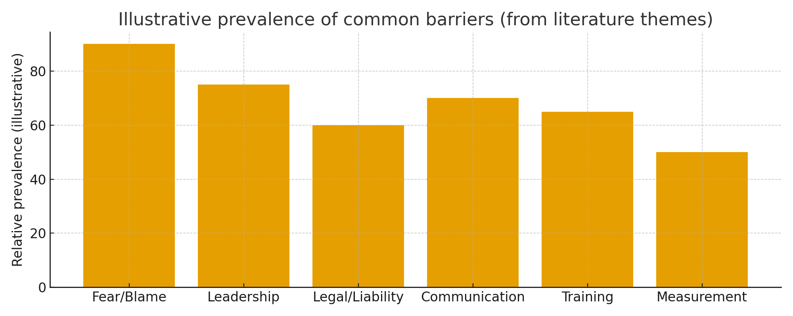

Slide 6
Deeper Look: Key Challenges
Fear of punishment -> underreporting of errors (undermines learning).
Leadership inconsistency -> mixed messages reduce trust in process.
Legal and public disclosure concerns -> organizations avoid transparency.
These themes are echoed across AHRQ, PubMed reviews, and ECRI analyses.

Slide 7
Strategies to Overcome Barriers
• Visible leadership commitment and consistent responses to events.
• Education/training on just culture principles for all staff.
• Clear policies distinguishing human error vs. reckless behavior.
• Protect reporting from punitive action; provide legal/PR guidance.
• Use metrics (reporting rates, safety culture surveys) to track progress.
• Embed learning via root-cause/system-focused investigations.

Slide 8
References (selected)
Murray J.S., 'Requirements for implementing a just culture' (2023) - PubMed Central. (pmc)
AHRQ, 'Understand Just Culture' (CUSP toolkit) - AHRQ.gov.
David Marx, 'Patient Safety and the “Just Culture”' (2001) - Marx Primer.
ECRI, 'Just Culture and Its Critical Link to Patient Safety' (analysis).
Additional articles: Frontiers, Nursing Management, IHI Blueprint.

